Slide 1

יניב אורן 203243431
אביב רוזיה 201411477
משה מלכה 204769426
מושיקו נגרין 301034294

Slide 2
What is RC5
RC5 is a block cipher notable for its simplicity. Designed by Ronald Rivest in 1994.
RC stands for "Rivest Cipher", or alternatively, "Ron's Code.
Rivest announced also RC2 and RC4 and now there is RC6 which is The Advanced Encryption Standard (AES) candidate (RC6 was based on RC5).

Slide 3
Features
Symmetric block cipher (Like Feistel Network Structure)
  the same secret cryptographic key is used for encryption and decryption
Suitable for hardware and software
  It uses only computational primitive operations commonly found on typical microprocessors
Fast
  Cause it uses Word-Oriented operations

Slide 4
Features
Simple
  It is simple to implement, This simplicity makes it more interesting to analyze and evaluate, so that the cryptographic strength can be more rapidly determined
Low memory requirements
  So it is easily implemented on devices with restricted memory
Data-dependent rotations
  RC5 highlight the use of data-dependent rotations and encourage the assessment of the cryptographic strength data-dependent can provide

Slide 5
.Features count
Adaptable to processors of different word lengths(16/32/64 bits)
  For example with 64 bit processor RC5 can exploit their longer work length
  Therefore the number w of bits in a word is a parameter of RC5, different choices of this parameter results different algorithms.
Variable number of rounds(0-255)
  The user can explicitly manipulate the trade-off between higher speed and higher security.
  So the number of rounds r is a second parameter of RC5

Slide 6
Features count.
Variable length cryptographic key(0-255 Bytes)
  The user can choose the level of security appropriate for his application the key length b in bytes is thus a third parameter of RC5

Slide 7
Features - Highlight
Data-dependent rotations
Variable block size
Variable number of rounds
Variable key size

Slide 8

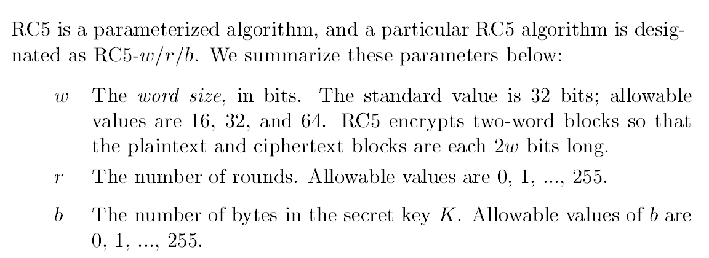

Slide 9
Parameterization count.
RC5 algorithm example: RC5-32/16/7
  similar to DES
  Two 32-bit word inputs and outputs
  16 rounds
  7-byte(56-bit) secret key
Choices for w and r
  speed vs. security
Choosing larger number of rounds provides an increased level of security

Slide 10
Default parameters
RC5 Default parameters
  The default is 32/12/ 7 for 32 bit words
  The default is 64/16/7 for 64 bit words
  So if any parameter is dropped use the corresponding default parameter
Examples
  RC5-32 Means 32/12/7
  RC5-32, 9 Means 32/9/7
  RC5-64 Means 64/16/7

Slide 11
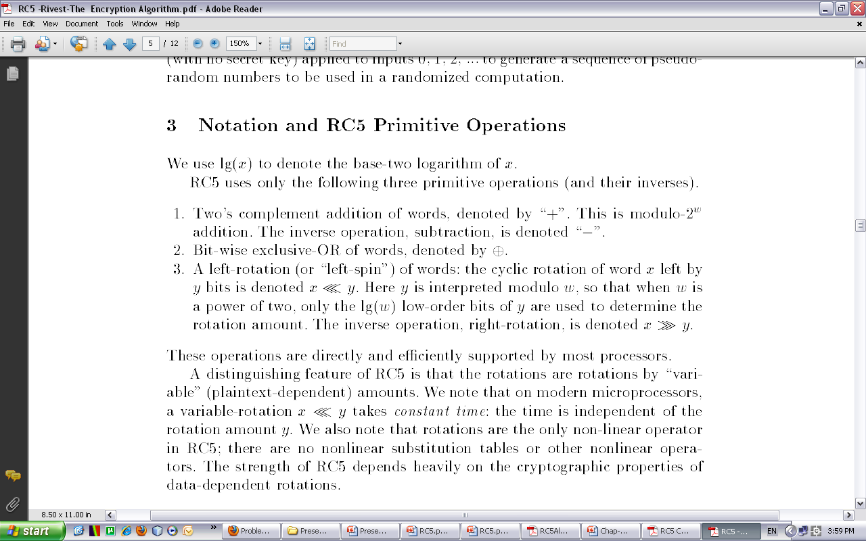
Notations and Primitive operations

Slide 12
Algorithm
The are three components of RC5
  Key expansion algorithm
  Encryption algorithm
  Decryption algorithm
Plaintext
Encryption
Algorithm
Ciphertext
Secret Key K
Key Expansion
Algorithm
Expanded Key S
Decryption
Algorithm
Plaintext
Ciphertext

Slide 13
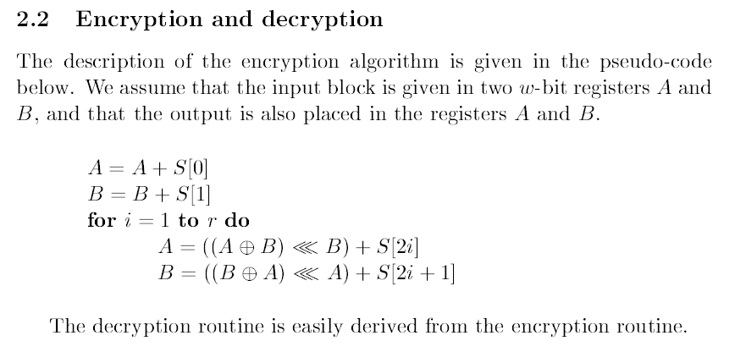
Encryption

Slide 14
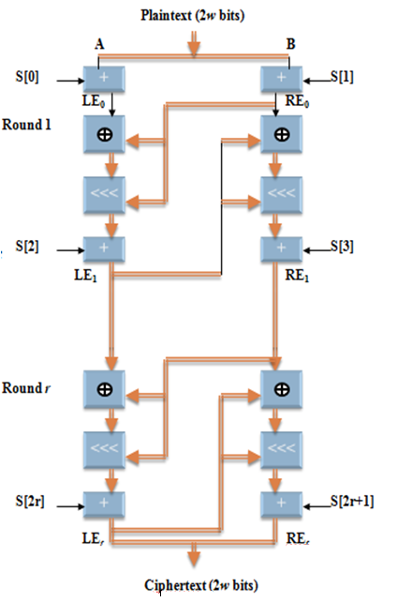
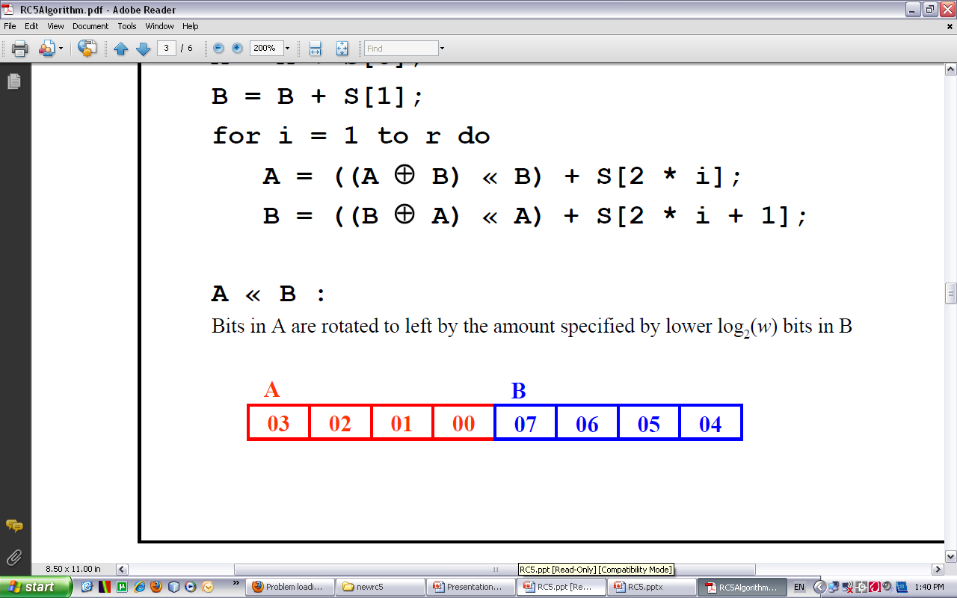
Encryption
A = A + S[0];
B = B + S[1];
for i = 1 to r do
A = ((A ⊕ B) <<< B) + S[2*i];
B = ((B ⊕ A) <<< A) + S[2*i + 1];
A <<< B
Bits in A are rotated to left by the amount specified by lower log2(w) bits in B

Slide 15
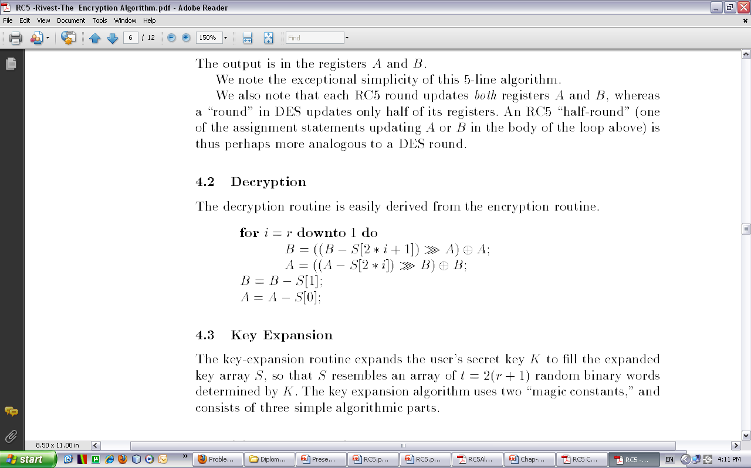
Decryption

Slide 16
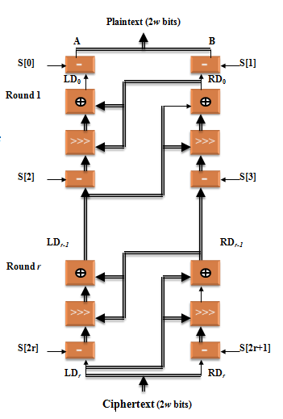
Decryption
  for i = r downto 1 do
  B = ((B - S[2*i +1]) >>> A) ⊕ A;
  A = ((A - S[2*i]) >>> B) ⊕ B;
  B = B - S[1];
  A = A - S[0];
A >>> B
Bits in A are rotated to right by the amount specified by lower log2(w) bits in B

Slide 17
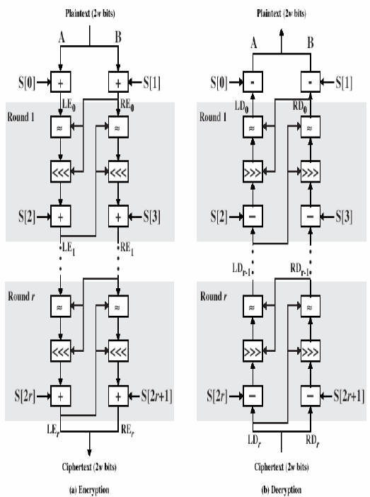
Encryption and Decryption

Slide 18
Key Expansion
RC5
RC5 performs some operations on the secret key to generate a total of t sub keys, which are stored in S array, S[0],S[1], …, S[t-1]
  has t entries, t = 2(r + 1) w-bit words
The key expansion algorithm consists of two constants (Magic numbers) and three simple algorithm parts
  Step-1: Convert secret key bytes to words
  Step-2: Initialize sub key array S (S[0], S[1], …, S[t-1])
  Step-3: Mix the secret key into sub key array S

Slide 19
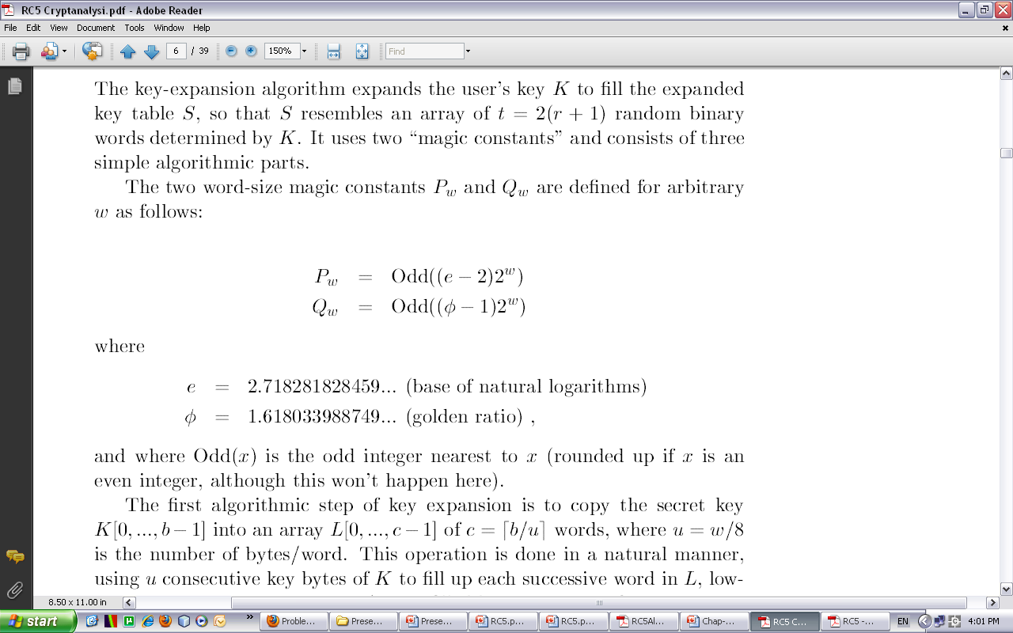
Key Expansion

Slide 20
The magic constants
In key expansion, magic constants are used
  P_{w} = Odd((e - 2)2^w); e=2.718281828…. (base of natural logarithms)
  Q_{w} = Odd((φ - 1)2^w); φ=1.618033988…. (golden ratio = (1+sqr(5))/2)
    Odd(x): odd integer nearest to x
  Example:
w 16 32 64
P_{w} B7E1 B7E15163 B7E151628AED2A6B
Q_{w} 9E37 9E3779B9 9E3779B97F4A7C15

Slide 21
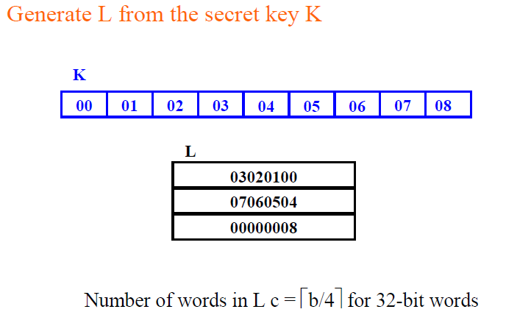
Step-1: Convert secret key bytes to words
Copy the Key into new array L of Words with size equal c
Any unfilled byte positions of L are zeroed
In case b = c = 0 we reset c =1 and set L[0] = 0
Notes:
In case of 16bits L=b/2
In case of 64bits L=b/8

Slide 22
Step-2: Initialize sub key array S
create an expanded key table,S[0...t-1]
  has t entries, t = 2(r + 1) w-bit words
Initialize array S
  S[0] = P_{w};
  for i = 1 to t - 1 do
  S[i] = S[i - 1] + Q_{w};

Slide 23
Step-3: Mix the secret key into sub key array S
Mix the secret key into table, S
i = j = 0; A = B = 0;
do 3 * max(t, c) times:
A = S[i] = (S[i] + A + B) <<< 3;
B = L[j] = (L[j] + A + B) <<< (A + B);
i = (i + 1) mod(t);
j = (j + 1) mod(c);

Slide 24
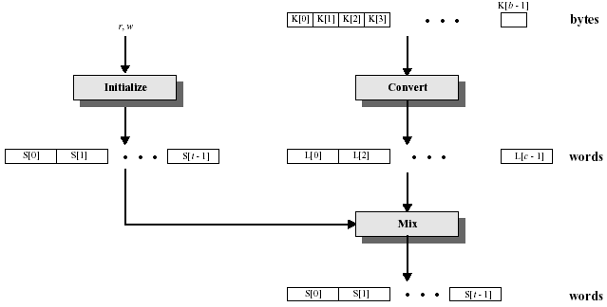
Key Expansion Algorithm

Slide 25
The security of RC5
Exhaustive Search
Differential cryptanalysis
Linear cryptanalysis
Timing Attacks

Slide 26
Exhaustive Search
  RC5-32/r/b allows
    a maximum of 2040 secret key bits
    a maximum of 25(2r + 2) expanded key table bits
  Choosing large values for r and b can prevent exhaustive attacks

Slide 27
Differential cryptanalysis
Pioneered by Eli Biham and Adi Shamir
It has a quite evolutionary effect on the design and analysis of block ciphers
A method that investigates the change in cryptographic strength when a change is made to the encryption algorithm
The basic Idea
  Two plaint text are chose with a certain difference P` (The difference here is measured by xor but for other cipher alternative measure may be applied)
  The two plaintexts are enciphered to give two cipher texts such that their difference C`
  Such a pair (P` , C`) is called a characteristic
  Depending on the cipher and the analysis the behavior of this characteristics can be useful in deriving certain bit of the key
Notes:
ניתוח הצפנה(קריפטאנליזה) דיפרנציאלית היא שיטה לניתוח צפנים. בצופני-בלוקים מטרת האנליזה היא למצוא היכן הצופן מתנהג בצורה שאינה אקראית וכך לגלות את המפתח.

Slide 28
Linear cryptanalysis
Introduced By Matsui.
The basic idea is
  to find relations among certain bits of plaintext, cipher text and key
  Such as relation is called linear approximation which can be used to obtain information about the key
Becomes impractical for r > 6
Notes:
ניתוח הצפנה(קריפטאנליזה) לינארית היא שיטה לניתוח צופן סימטרי (לרוב צופן בלוקים), שבה בידי התוקף טקסט גלוי וטקסט מוצפן מתאים ועליו לחשוף את סיביות המפתח או חלקן.
במהלך ניתוח הצופן, מחפש התוקף קירוב לינארי לפעולתו ובאמצעות הצבה של טקסטים ידועים גוזר ערכים מתוך המפתח.

Slide 29
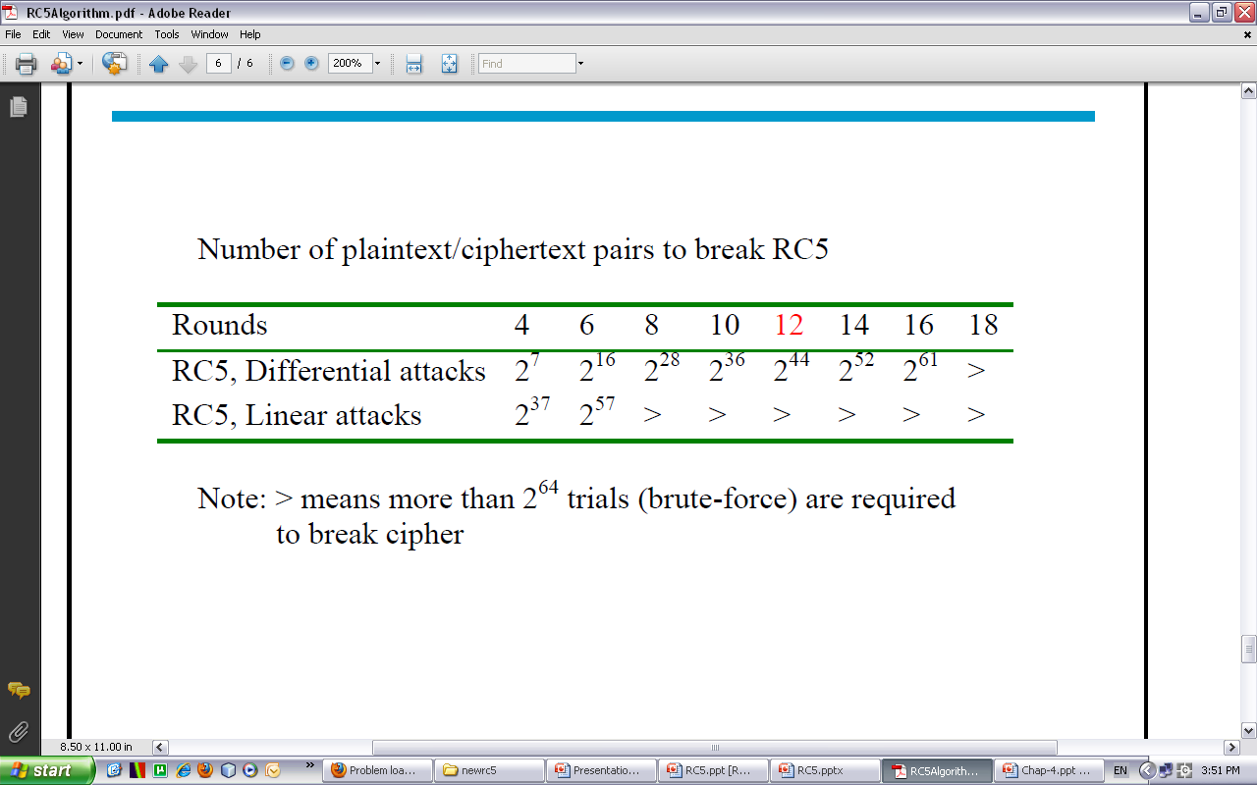
Differential and Linear attack

Slide 30
Timing Attacks
Developed by Kocher
The opponent can obtain some information about the secret key by recording and analyzing the time used for cryptographic operations that involve the key.
Kocher found that RC5 may be subject to Timing attack if RC5 is implemented on platforms for which the time for computing a single rotation is proportional to the rotation amount
RC5 can easily implemented to make the total time is data-independent (ex by computing the rotation of t bits using left-shift of t bits and right shift of w-t bits)
Notes:
התוקף לומד כמה זמן לוקח לאלגוריתם לעבוד לטקסטים שונים

Slide 31
RC6

Slide 32
Adapting Rc5 to AES(Advanced Encryption Standard)
Take advantage of a new primitive for increased security and efficiency: 32x32 multiplication, which executes quickly on modern processors, to compute rotation amounts.
Leverage our experience with RC5: use data-dependent rotations to achieve a high level of security.

Slide 33
Although there were no practical attacks against RC5, Studies have revealed a theoretical possibility of attack, as a result RC6 was developed, in order to adapt RC5 to meet the AES requirements.

Slide 34
Description of RC6
RC6-w/r/b parameters:
  Word size in bits: w
  Number of rounds: r
  Number of key bytes: b
Key Expansion:
  Produces array S[ 0 … 2r + 3 ] of w-bit round keys.
Encryption and Decryption:
  Input/Output in 32-bit registers A,B,C,D

Slide 35
RC6 Primitive Operations
A + B Addition modulo 2^{w}
A - B Subtraction modulo 2^{w}
A ⊕ B XOR
A <<< B Rotate A left by amount in
low-order lg(w ) bits of B
A >>> B Rotate A right, similarly
(A,B,C,D) = (B,C,D,A) Parallel assignment
RC5
A x B Multiplication modulo 2^{w}

Slide 36
Key Expansion
Input: array L[ 0 … c-1 ] of input key words
Output: array S[ 0 … 2r+3 ] of round key words
Using 2 magic constants and 3 simple steps

Slide 37
Define magic constants
P_{W} = Odd( ( e – 2 ) 2 ^{W} )
Q_{W} = Odd( (φ– 1 ) 2^{W} )
e = 2.718281828459
φ= 1.618033988749
For w=16,24,32
P₁₆ = 1011011111100001= b7e1；
Q₁₆ = 1001111000110111= 9e37；
P₃₂ = 10110111111000010101000101100011= b7e15163；
Q₃₂ = 10011110001101110111100110111001= 9e3779b9；
P₆₄ = b7e151638aed2a6b；
Q₆₄ = 9e3779b97f4a7c15。

Slide 38
Key Expansion Procedures
Step1:
  K[0…b-1] -> L[0…c-1]
Step2: initialize S[0….2r+3]
  S[0] = P_{W} ;
  for i = 1 to 2r+3 do
  S[i]=S[i - 1]+ Q_{W} ;

Slide 39
Step3:
  i = j = 0 ;
  A = B = 0 ;
  for h = 1 to 3*max( 2r+4 , c ) do S[i] = ( S[i] + A + B ) <<< 3； L[j] = ( L[j] + A + B ) <<< ( A + B )； A=S[i]; B=L[j];
  i = ( i + 1 ) mod ( 2r + 4 )；
  j = ( j + 1 ) mod c；

Slide 40
RC6 Encryption(one round)
B = B + S[ 0 ]
D = D + S[ 1 ]
for i = 1 to r do
{
t = ( B x ( 2B + 1 ) ) <<< lg( w )
u = ( D x ( 2D + 1 ) ) <<< lg( w )
A = ( ( A ⊕ t ) <<< u ) + S[ 2i ]
C = ( ( C ⊕ u ) <<< t ) + S[ 2i + 1 ]
(A, B, C, D) = (B, C, D, A)
}
A = A + S[ 2r + 2 ]
C = C + S[ 2r + 3 ]

Slide 41
One Round of RC6
B = B + S[ 0 ]
D = D + S[ 1 ]
for i = 1 to r do
{
t = ( B x ( 2B + 1 ) ) <<< lg( w )
u = ( D x ( 2D + 1 ) ) <<< lg( w )
A = ( ( A ⊕ t ) <<< u ) + S[ 2i ]
C = ( ( C ⊕ u ) <<< t ) + S[ 2i + 1]
(A, B, C, D) = (B, C, D, A)
}
A = A + S[ 2r + 2 ]
C = C + S[ 2r + 3 ]
A
B
C
D
t
u
<<<
f
<<<
f
<<<
<<<
S[2i]
S[2i+1]
A
B
C
D

Slide 42
RC6 Decryption (one round)
C = C - S[2r + 3]
A = A - S[2r + 2]
for i = r downto 1 do
{
(A, B, C, D) = (D, A, B, C)
u = (D*(2D + 1)) <<< lg w
t = (B*(2B + 1)) <<< lg w
C = ((C - S[2i + 1]) >>> t) ⊕ u
A = ((A - S[2i]) >>> u) ⊕ t
}
D = D - S[1]
B = B - S[0]

Slide 43
One Round of RC6
C = C - S[2r + 3]
A = A - S[2r + 2]
for i = r downto 1 do
{
(A, B, C, D) = (D, A, B, C)
u = (D*(2D + 1)) <<< lg w
t = (B*(2B + 1)) <<< lg w
C = ((C - S[2i + 1]) >>> t) ⊕ u
A = ((A - S[2i]) >>> u) ⊕ t
}
D = D - S[1]
B = B - S[0]
A
B
C
D
t
u
<<<
f
<<<
f
<<<
<<<
S[2i]
S[2i+1]
A
B
C
D

Slide 44


Slide 45
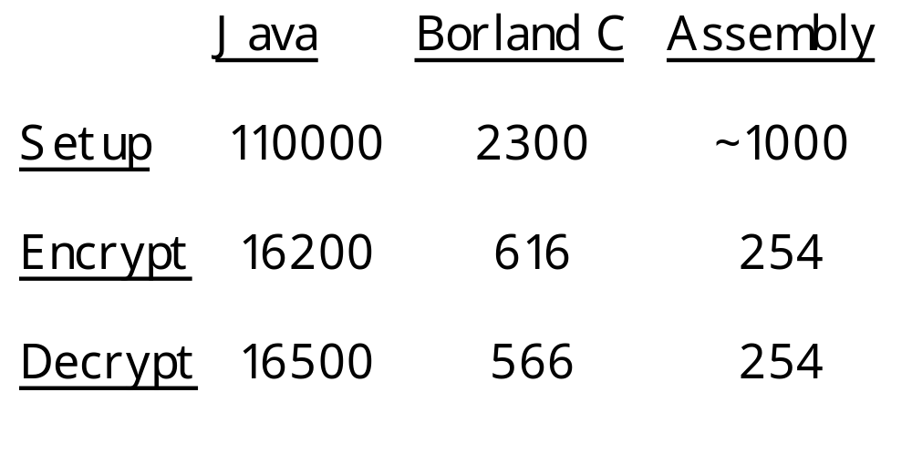
CPU Cycles / Operation
Less than two clocks per bit of plaintext !

Slide 46
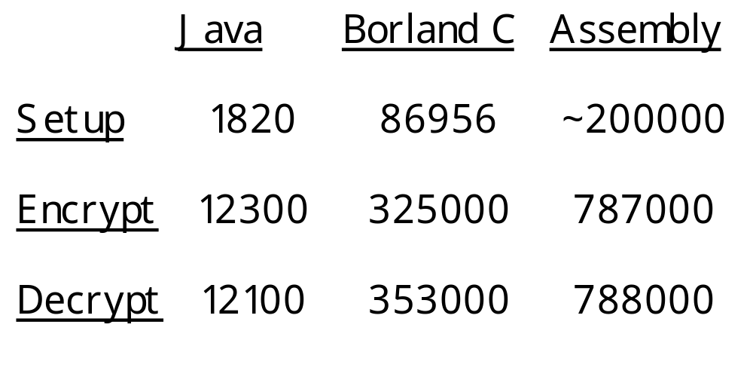
Operations/Second (200MHz)

Slide 47
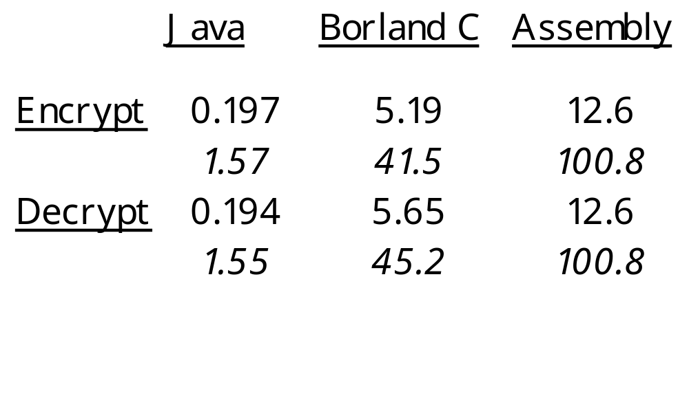
Encryption Rate (200MHz)
MegaBytes / second
MegaBits / second
Over 100 Megabits / second !

Slide 48


Slide 49
Security against linear attacks
Estimate of number of plaintext/ciphertext pairs required to mount a linear attack.
(Only 2¹²⁸ such pairs are available.)
Rounds Pairs
8 2⁴⁷
12 2⁸³
16 2¹¹⁹
20 RC6 2¹⁵⁵
24 2¹⁹¹
Infeasible

Slide 50
Security against differential attacks
Estimate of number of plaintext pairs required to mount a differential attack.
(Only 2¹²⁸ such pairs are available.)
Rounds Pairs
8 2⁵⁶
12 2⁹⁷
16 2¹⁹⁰
20 RC6 2²³⁸
24 2²⁹⁹
Infeasible

Slide 51
RC5 Vs. RC6
RC5 | RC6
w=32, r=20, bϵ{16,24,32} |  | התקן שנקבע w/r/b
2r+2 | 2r+4 | גודל מערך המפתחות
2 | 4 | מספר המילים בקלט
פשוט יותר, ביצוע פעולות על 2 המילים | מורכב יותר, ביצוע פעולות על 2 מילים ופעולות אחרות על 2 המילים האחרות. | אלגוריתם ההצפנה/פענוח

Slide 52
Security of Key Expansion
Key expansion is identical to that of RC5; no known weaknesses.
No known related-key attacks.
Round keys appear to be a “random” function of the supplied key.

Slide 53
Conclusion
Provides good security against the four main attacks
Simple encryption / decryption algorithms
Very fast and practical
Adaptive to environment of running
Customable parameters to fit user’s needs

Slide 54
Thank you for your
attention

